Slide 1
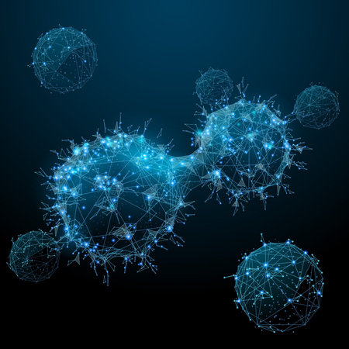
Bioinformatics Project Using R Language
MELONOMA CANCER
Team Members:
Sara Ashraf- Rana Hamed –Reem Osama –Sara Ahmed.

Slide 2
Melanoma is the deadliest type of skin cancer, characterized by high cellular heterogeneity which is resistant to radiotherapy as it can’t find specific type of cell can kill so it leads to unpredictable disease outcome.
Recently, by correlating Reflectance-Confocal-Microscopy (RCM) morphology with histopathological type, we identified four distinct melanoma-subtypes: dendritic-cell (DC), round-cell (RC), dermal-nest (DN), and combined-type (CT) melanomas.
Our results show that each melanoma subtypes has a distinct biological and gene expression profile, related to tumor aggressiveness, confirming that RCM can be a dependable tool for in vivo detecting different types of melanoma and for early diagnostic screening.

Slide 3
As PUBMED in NCBI referenced in melanoma in its article expressing the possible ways to diagnose the disease and be able differentiate its cells .
PUBMED ARTICLE:
PMID: 8970588:The diagnosis of malignant melanoma requires clinical recognition of suspect lesions, biopsy, and histologic examination.
Histological features which serve to distinguish malignant melanoma from their benign counterparts can be found in both the epidermis and dermis.
Nested melanocytes can be found along the basal layer in malignant melanoma, but these nests are usually quite variable in size .
Other cytological features can also be useful in the diagnosis of malignant melanoma, particularly when there is marked cytological atypia(the presence of nuclei that are large, regularly shaped and where color of blood less normal under microscope)
however, in some lesions, the cytological changes are not so pronounced and correct diagnosis depends on evaluation of growth pattern.
While distinguishing between melanoma and atypical moles can be difficult. So the RCM (reflectance confocal microscopy)is considered the best technique to distinguish due the difficulty as a result of its different types of cells. The pathology report of a melanoma should include the diagnosis, the maximum thickness of the tumor.
Which is provided by (RCM)by its histo-pathology technique.

Slide 4
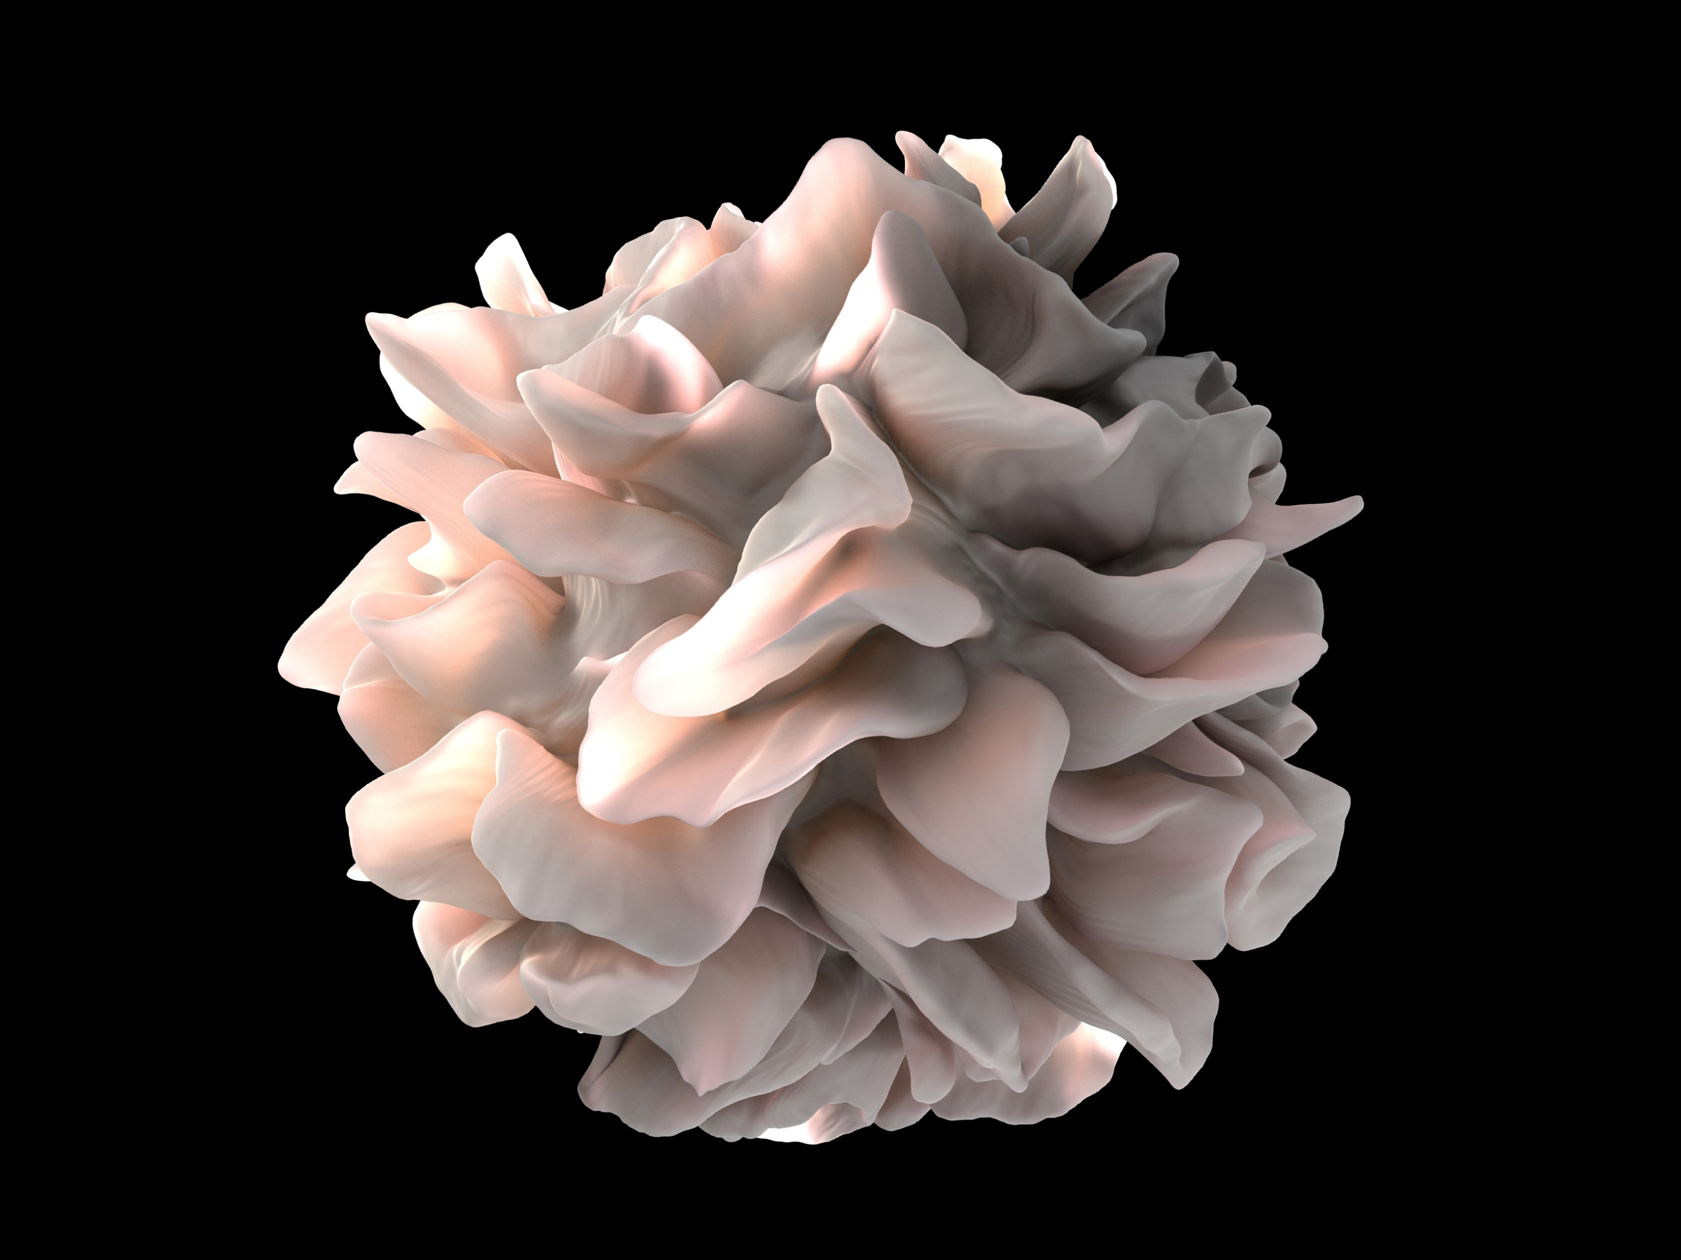
Dendritic_cell_revealed.

Slide 5
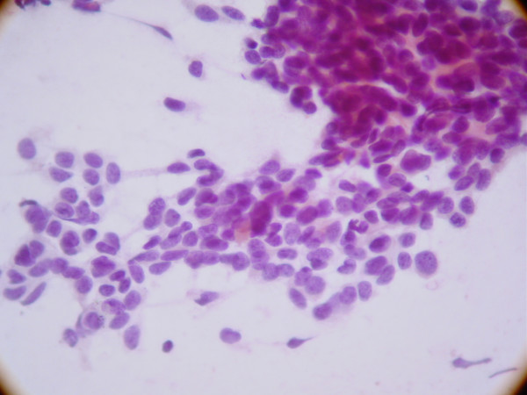
Round cell(RC)

Slide 6
Reference:
A benign (not cancer):
growth on the skin that is formed by a cluster of melanocytes (cells that make a substance called melanin, which gives color to skin and eyes).
- A nevus is usually dark and may be raised from the skin.
(The nevus)
Keratinocytes are the predominant cell type of epidermis and originate in the basal layer, produce keratin, and are responsible for the formation of the epidermal water barrier by making and secreting lipids.
What is a “melanocyte nest” ?
Nests of melanocytes are confined to the dermis.

Slide 7
Reference:
Melanocytes may show 'pseudo-inclusions', which are invaginations of cytoplasm into the nucleus giving the appearance of nuclear inclusions or cells with multiple nuclei.
Deeper, the naevus cells may become spindle-shaped or 'neurotised’.
What does “Hypochromic” mean?
Hypochromia means that the red blood cells have less color than normal when examined under a microscope
Cytologic atypia is defined by the presence of nuclei that are large, regularly shaped and hyperchromic

Slide 8
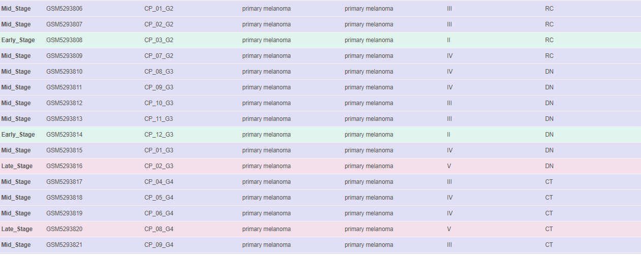
Data From GEO database

Slide 9
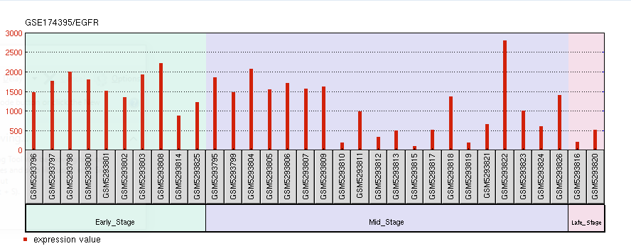
Classification of data

Slide 10
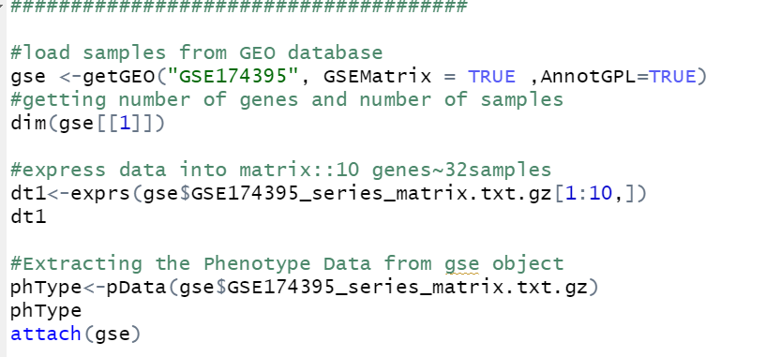
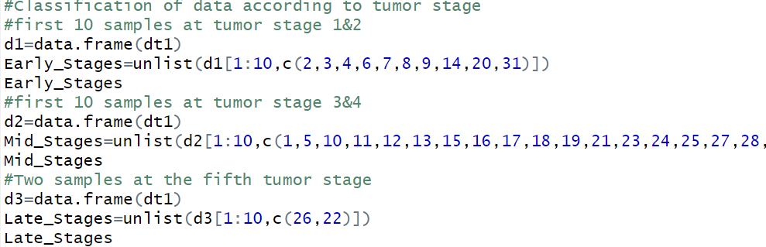
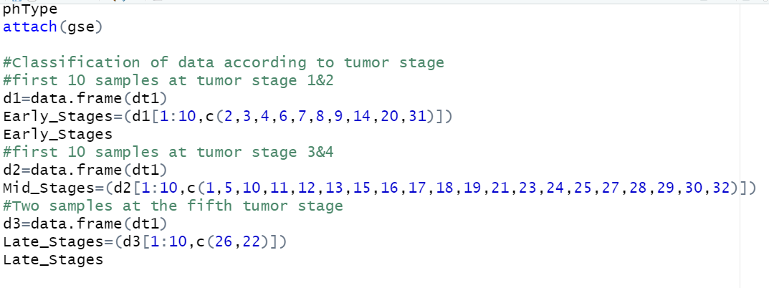
1-downloading packages.
2-work on 32 samples .
3-classify data based on cancer level.

Slide 11
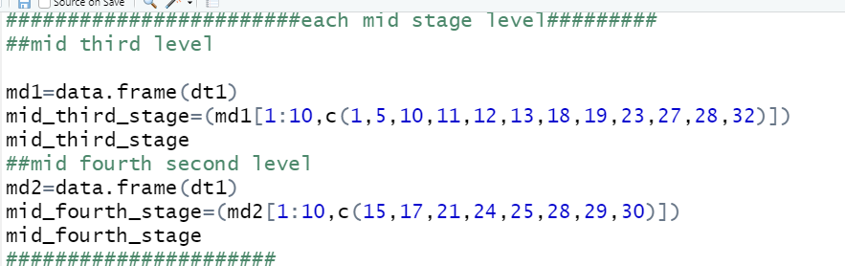
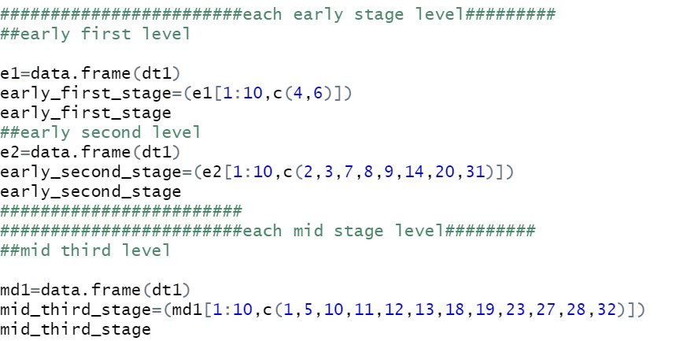
Classify each level as we have 5 stages of cancer (1,2,3,4,5) levels.

Slide 12

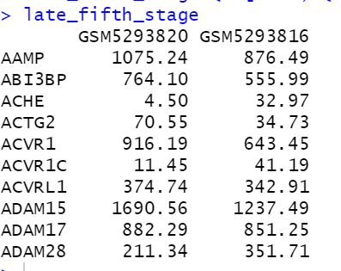
We grouped level (1,2) of cancer stages as early stage
-Level(3,4) as mid stage
-Level(5) as late stage

Slide 13
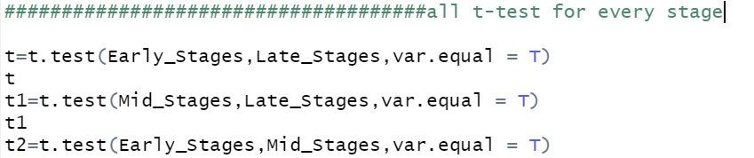
T-test Analysis

Slide 14
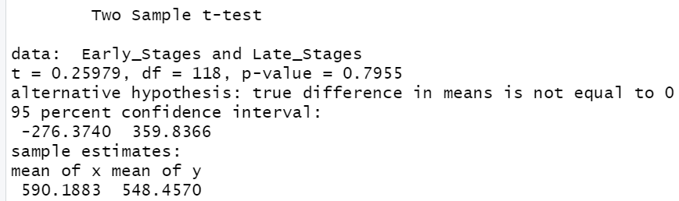
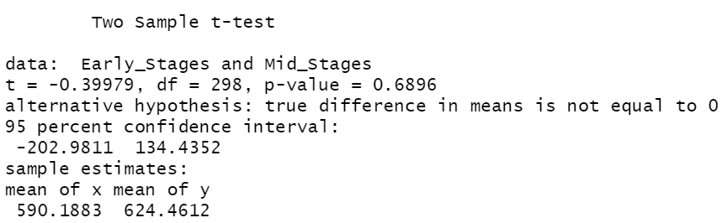
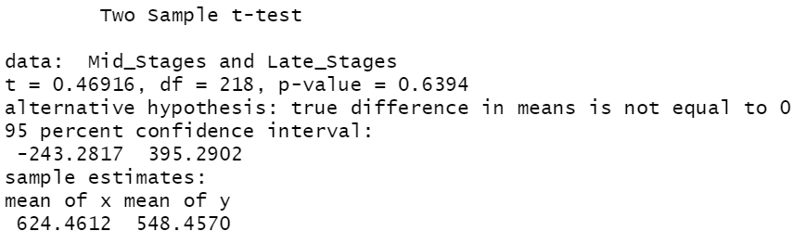
T-test for (early and late-stages)
T-test for (early and mid-stages)
T-test for (late and mid-stages)

Slide 15
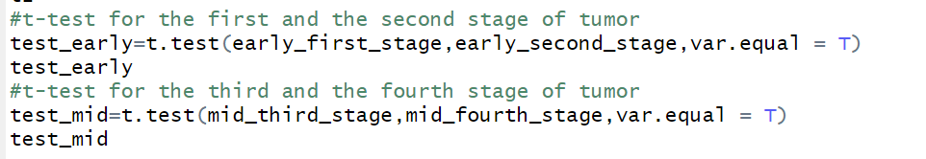
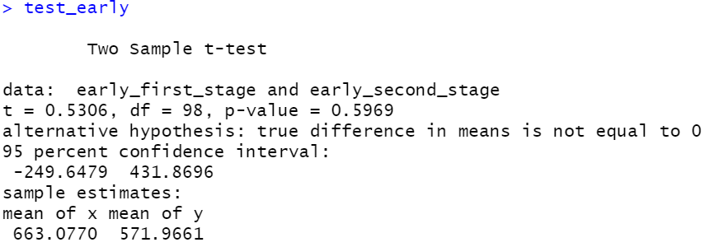
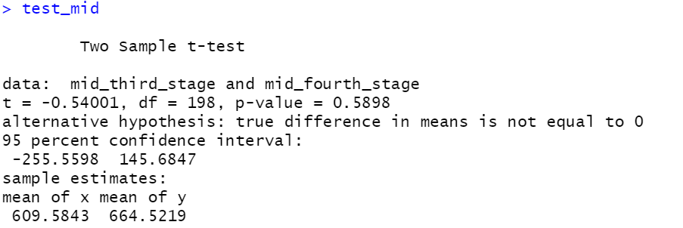
T-test for (early level(1)stage and early level(2)stage )
T-test for (early level(1)stage and early level(2)stage )

Slide 16
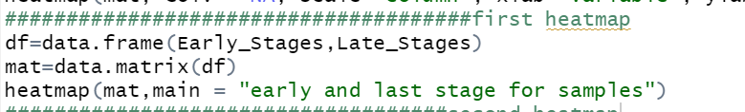
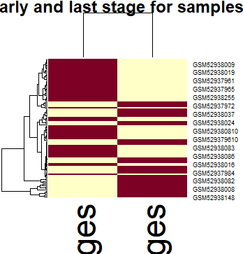
Heatmaps
Heatmap for early and last stage of cancer

Slide 17
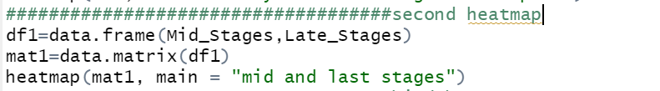
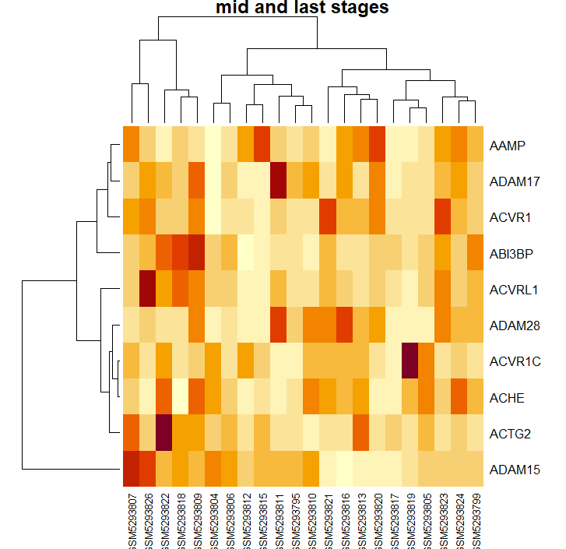
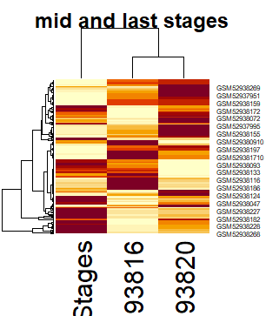
Heatmap for mid and last stage of cancer

Slide 18
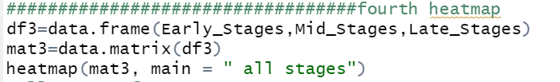
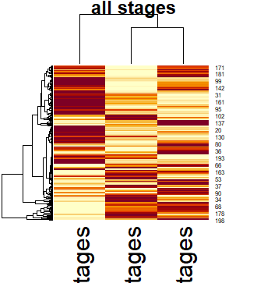
Heatmap for all Stages of cancer

Slide 19
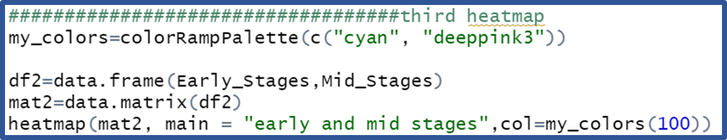
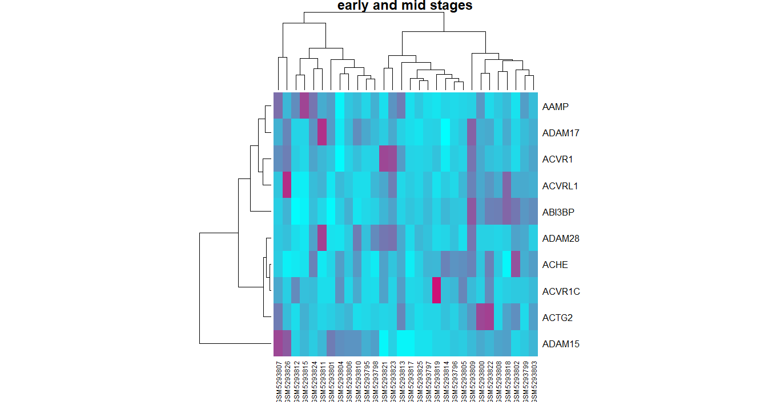
Heatmap for all Stages of cancer

Slide 20
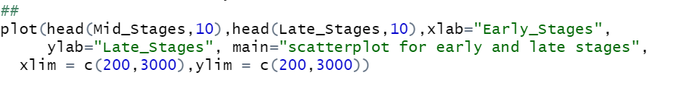
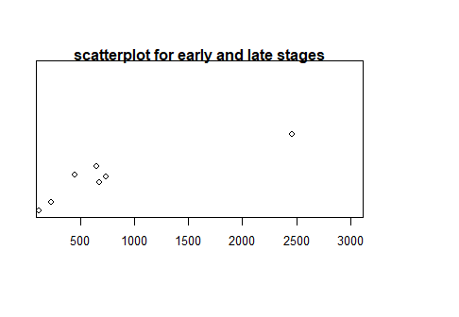
Scatterplot

Slide 21
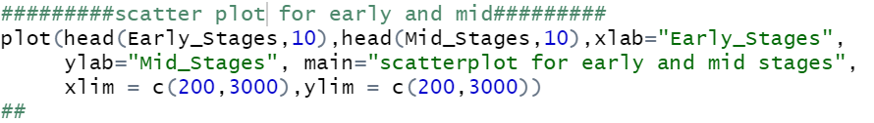
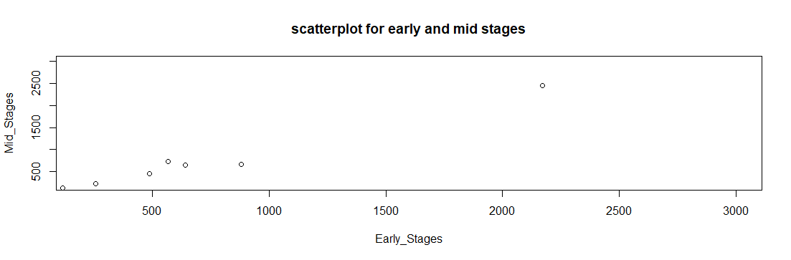

Slide 22
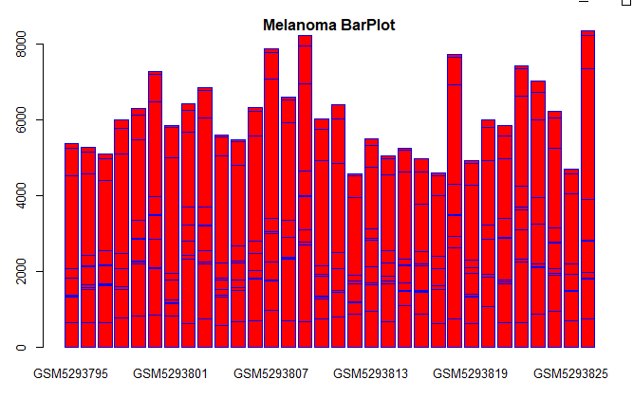
Barplot

Slide 23
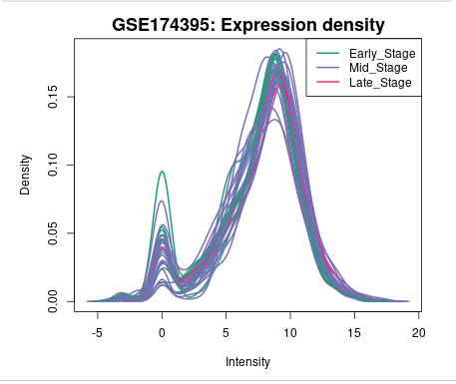
Density diagrams is considered as similar as histogram but it’s much smoother than it.
They both mainly use the concept as it helps us here to explain the distribution of large data sets of gene expression of melanoma cancer as histograms is used to easily explain the majority of values fall on a measurement scale and it starts to compare by using a kernel density estimate to show the probability density function of the variable (as shown it considered us the distribution of impact of single gene (melanoma subtype) on every stage and the distribution of this impact as the highest density probability of a specific gene on more than one sample of same stage or more severe in diagnosis and visualization and how much variation is there among the stages and subtypes related to RCM technique used for a specific gene maybe in same stage or differ for melanoma cancer which definitely ensures the heterogeneity of melanoma cells and it difficulty to be diagnosed or screened.

Slide 24
Thank you
for
reading

